Slide 1
4.4 The MVT for integrals
(average value over an interval)
and the
1st & 2nd FTC
Chris Thiel, OFMCap, 2021

Slide 2
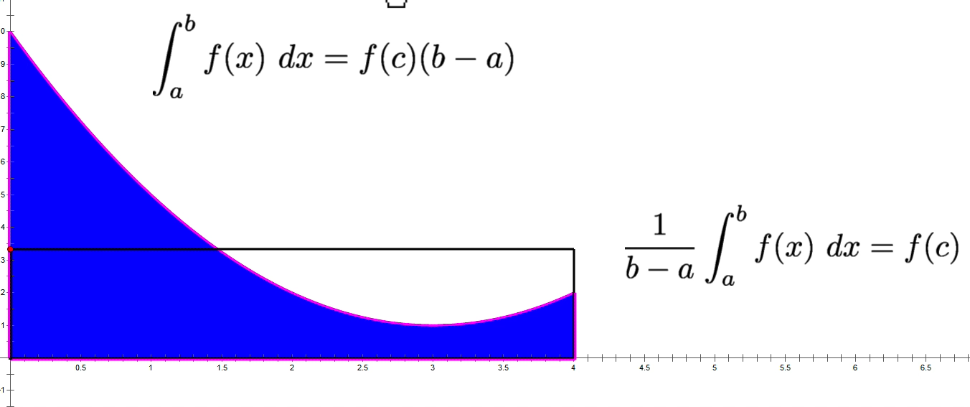
Average Value on a Interval
Mean Value Theorem for Integrals
(Thanks Jim O'Connor for this Animation!)
Notes:
We start with something that is sometimes referred to by the confusing title "MVT for integrals."
The problem with that title is that beginners will think confuse it with the "MVT for derivatives".
This theorem has something to say about an average VALUE, while the other has something to say about the AVERAGE RATE. ----- The idea is that there must be a rectangle out there that has the same base as the bounds of the definite integral, that has the same area as the definite int,.. the height of that rectangle is the AVERAGE VALUE

Slide 3
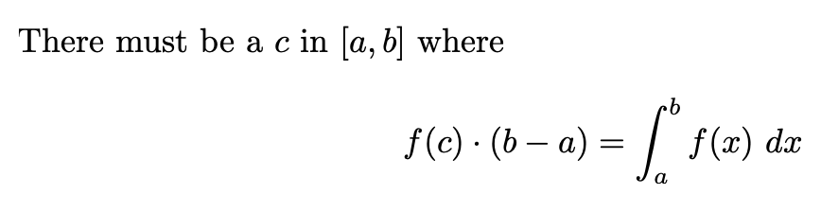


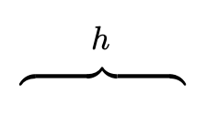







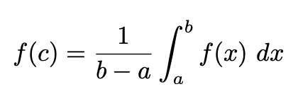

Slide 4
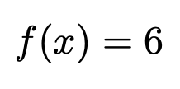

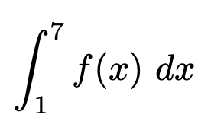
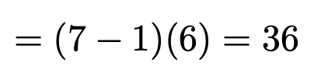
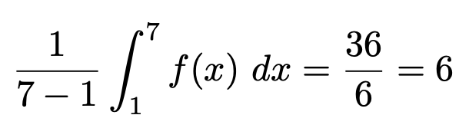


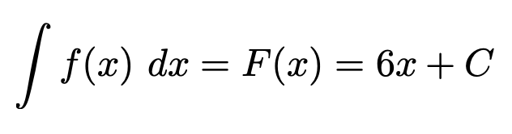
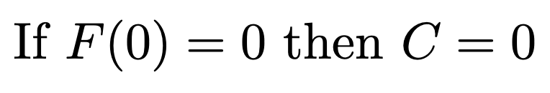
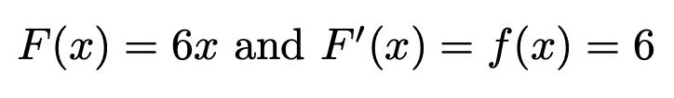
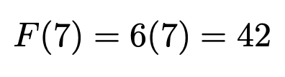
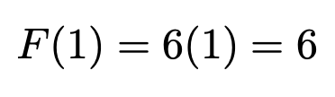
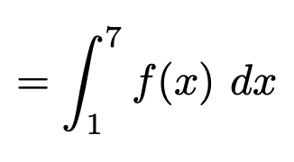

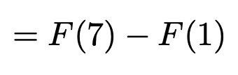
Using Geometry..
Using Calculus..
Notice this..
Will this ALWAYS work?
Notes:
This constant function clearly has an average value of 6 on [1,7], as it is always 6.
Let's confirm it works with the MVT for Integrals. Using Geometry, the area is 36, div by the difference 7-1 we do indeed get 6
Rather than using Geometry, though let's find the Antiderivative

Slide 5
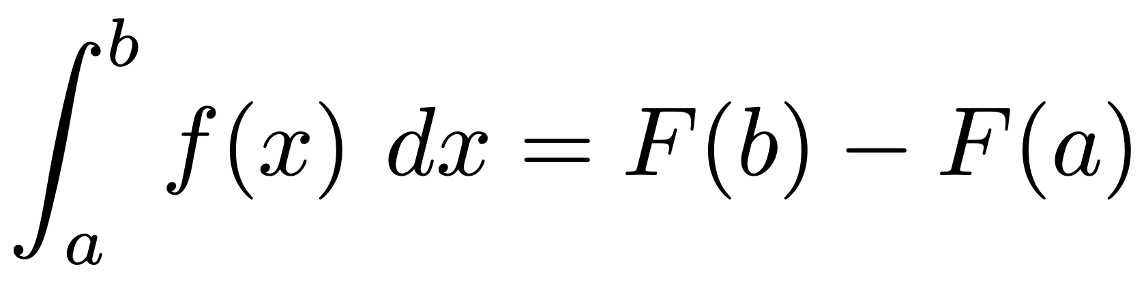


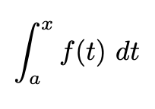
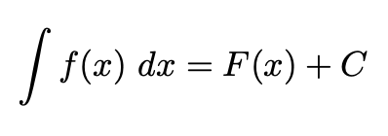

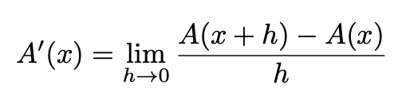
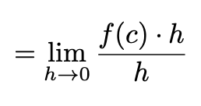
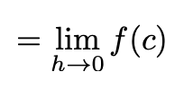


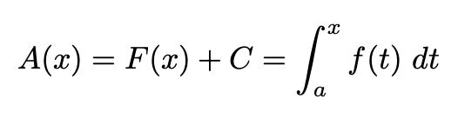
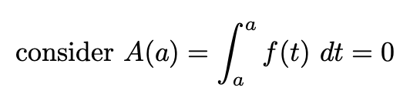

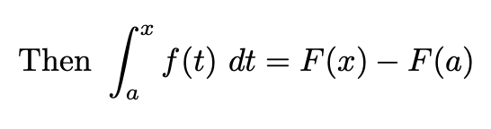
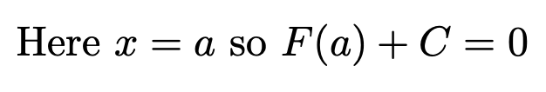

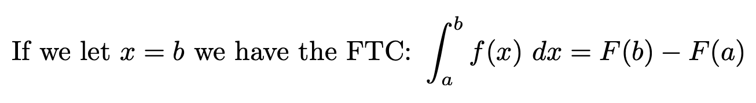
Claim:
... and ...
Notes:
Let's start with the left side of our claim, and [1] draw a representative continuous function f(x) and lower limit a [2] that goes to an upper limit we will call x. [3] This way I can have an [4-5] Area function from a to x, and as a definite integral,
...AND... [6] belongs to some family of Antiderivative functions F(x)+C, where every one will have the same derivative F' which happens to be our function f.
[7]Using the limit definition of the derivative of A, we need to put on our graph the [8] upper limit x+h, and to find our limit as h goes to 0, we want to work out the difference between A(x+h) and A(x). That would be the difference in areas[9-].
As h to 0, this would converge to this skinny orange rectangle with height f(c) and width h [15]. the h cancels[16], and we see the limit goes to f(c) [17] goes to f(x) [18].
So the derivative of A is f(x), so [19]A is an antiderivative of f, and can be written [20] as one of the family of functions F(x) +C. To find out which one, we need a known value of A(x) so we can solve for C.
[22] So what not x= a? [23] There is no area between and a, so A(a) =0 so we substitute that in So we can find C. Well for this to be 0, [24] C must = -F(a)
[25] WE put this together and we have the particular function from our family of Antiderivatives F.
If x=b, [26] we have established our claim AKA the Fist FTC.

Slide 6
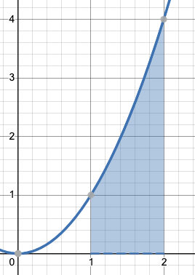
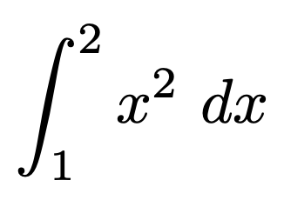
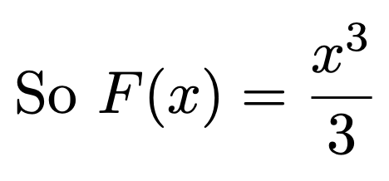
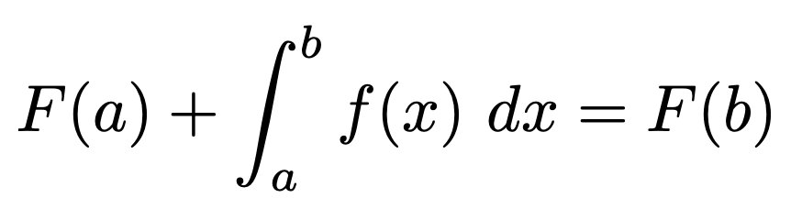
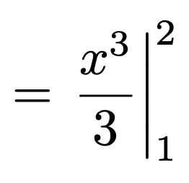
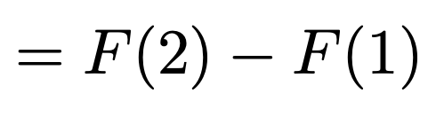
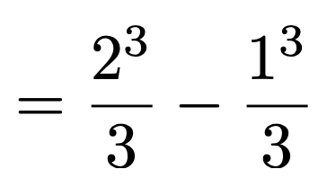
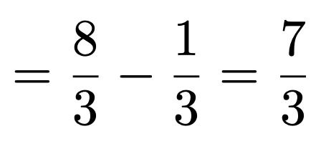
4.4 The First Fundamental
Theorem of Calculus

Slide 7
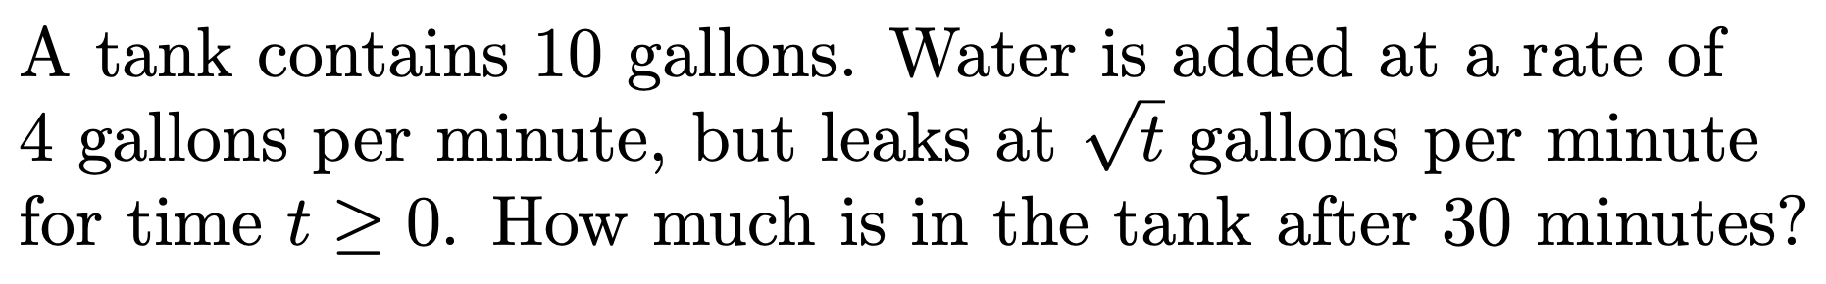
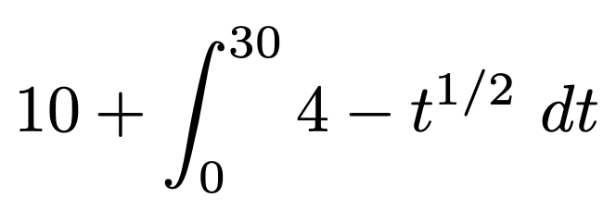
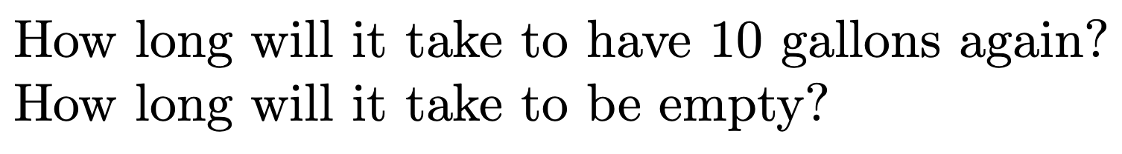
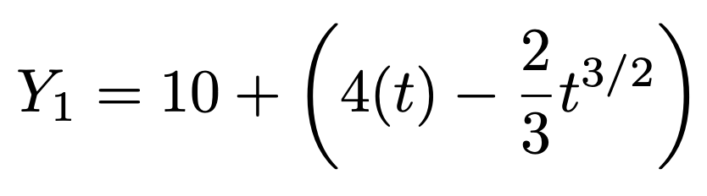
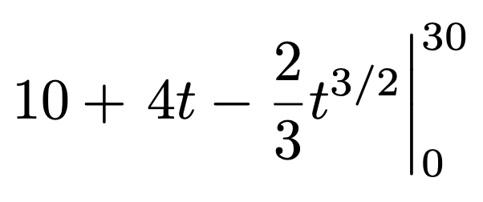
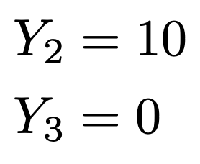
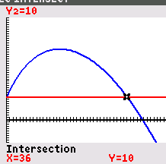
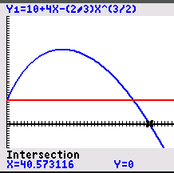
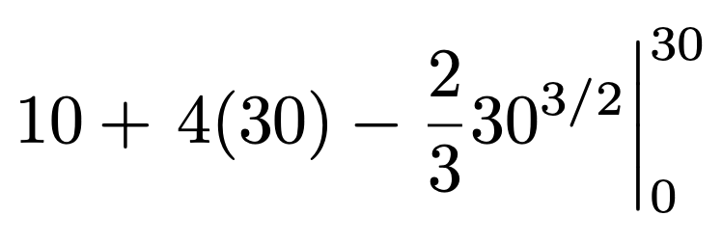
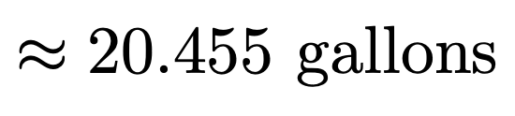

The Net Change "Theorem"

Slide 8
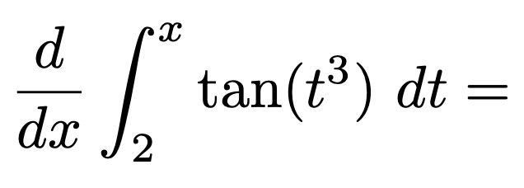
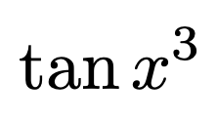
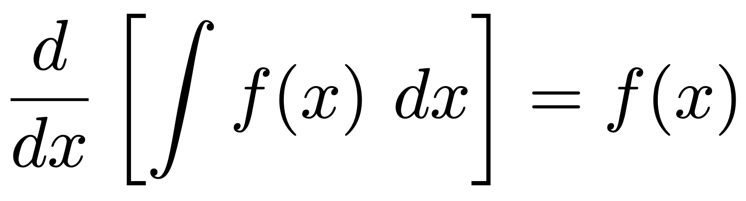
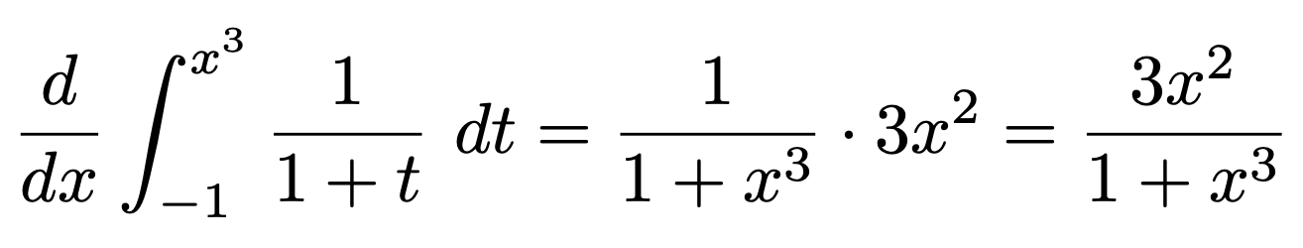
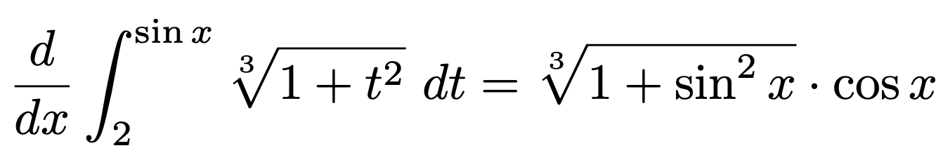
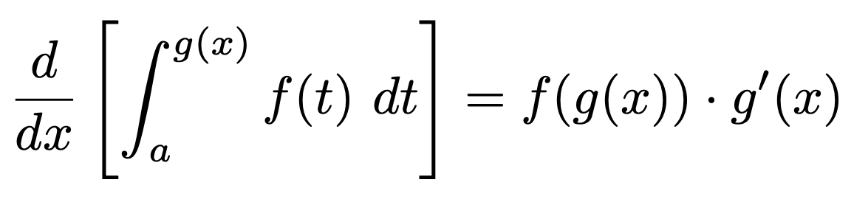

The Second Fundamental
Theorem of Calculus
Or the "Chain Rule" Version:
Notes:
Lower bound can be any constant, and the derivative of a constant is always 0.

